Slide 1

Continuous Everything With Jenkins X
- Why You Should Care
Juni Mukherjee @JuniTweets @ CloudBees

Slide 3
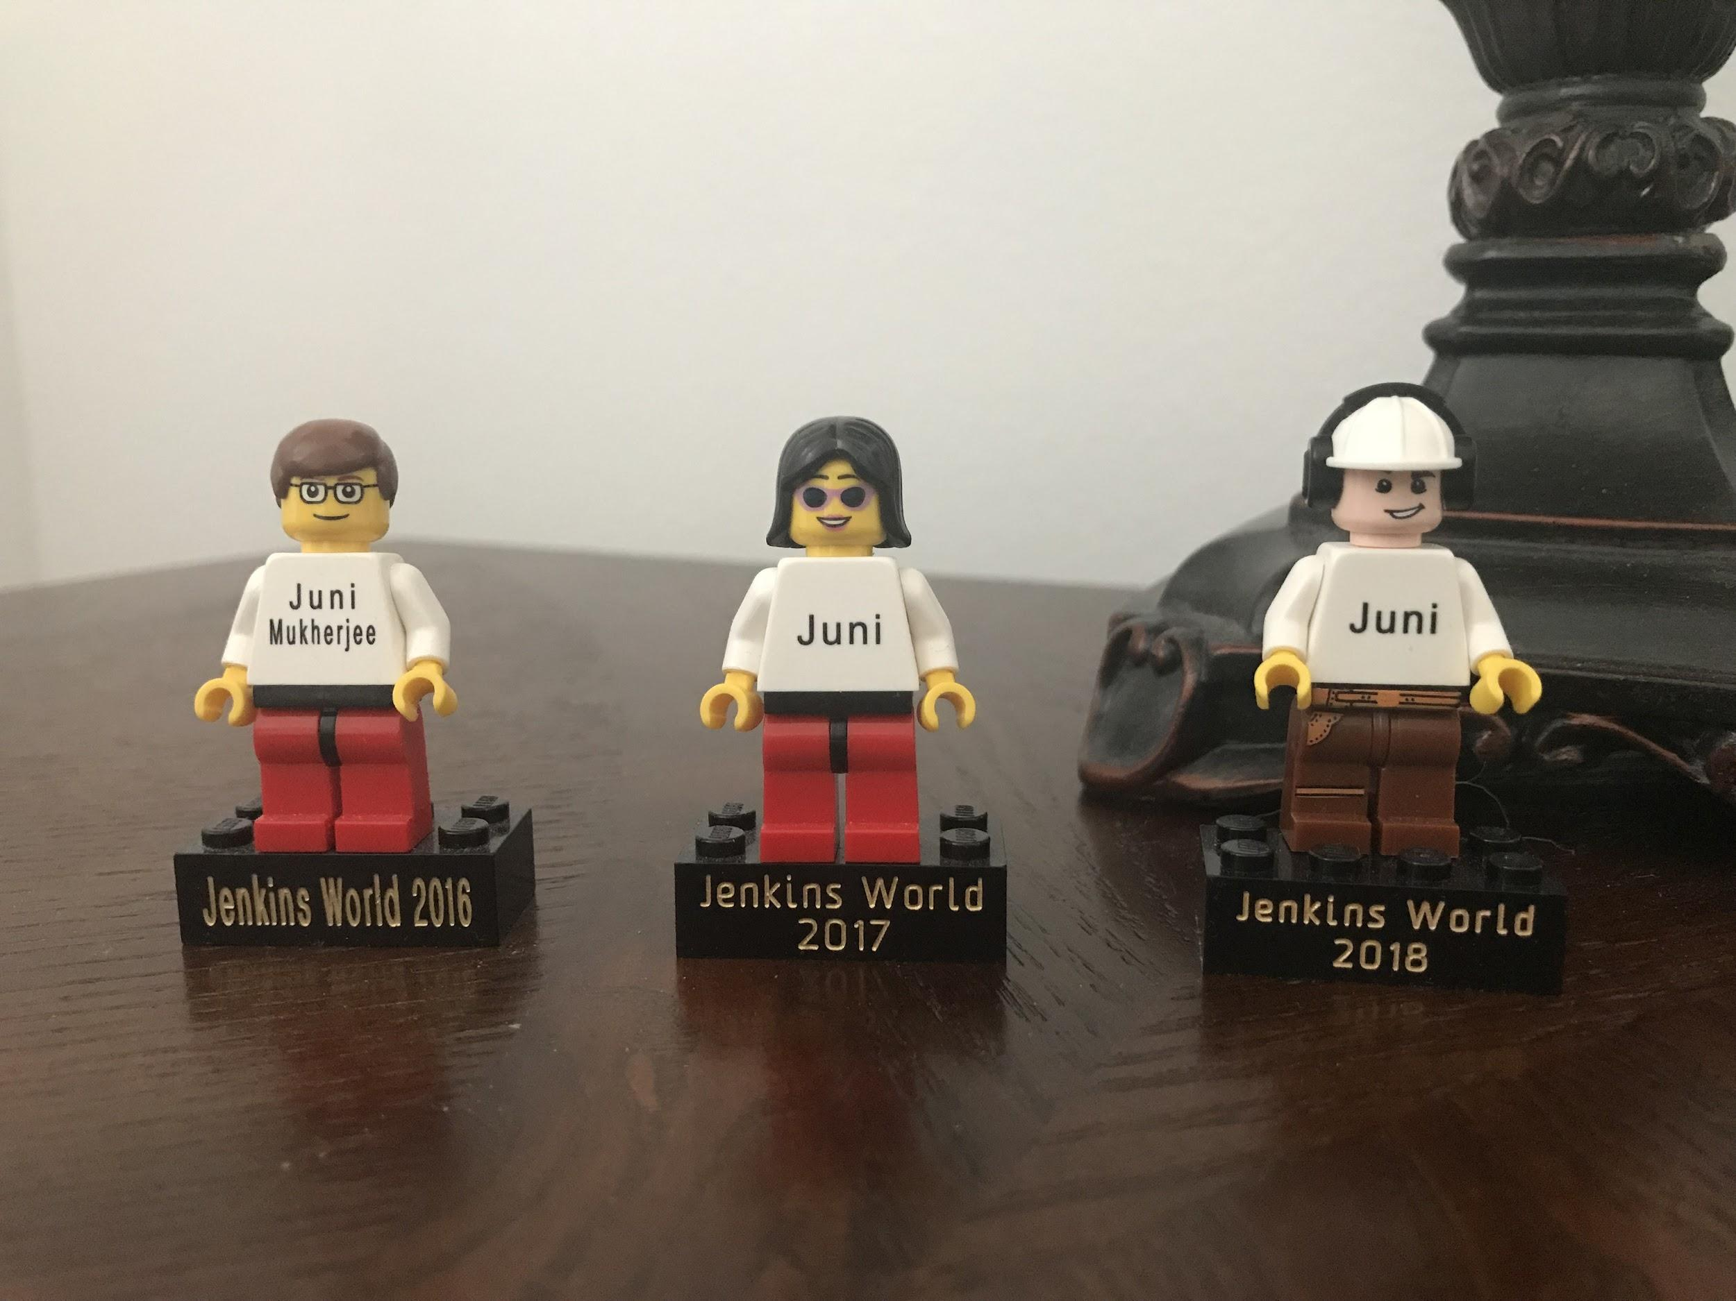
Thank you CloudBees and Sonatype!

Slide 4

What’s the best way to start the continuous journey?
Sometimes You Just Got To Do It!
And That Too With Pride!

Slide 5
Jenkins X - Why You Should Care
Jenkins X - Streamlined OSS CI/CD
For Cloud Apps On Kubernetes
GitOps - Manage Environments, Apps
And App Versions in Git

Slide 6
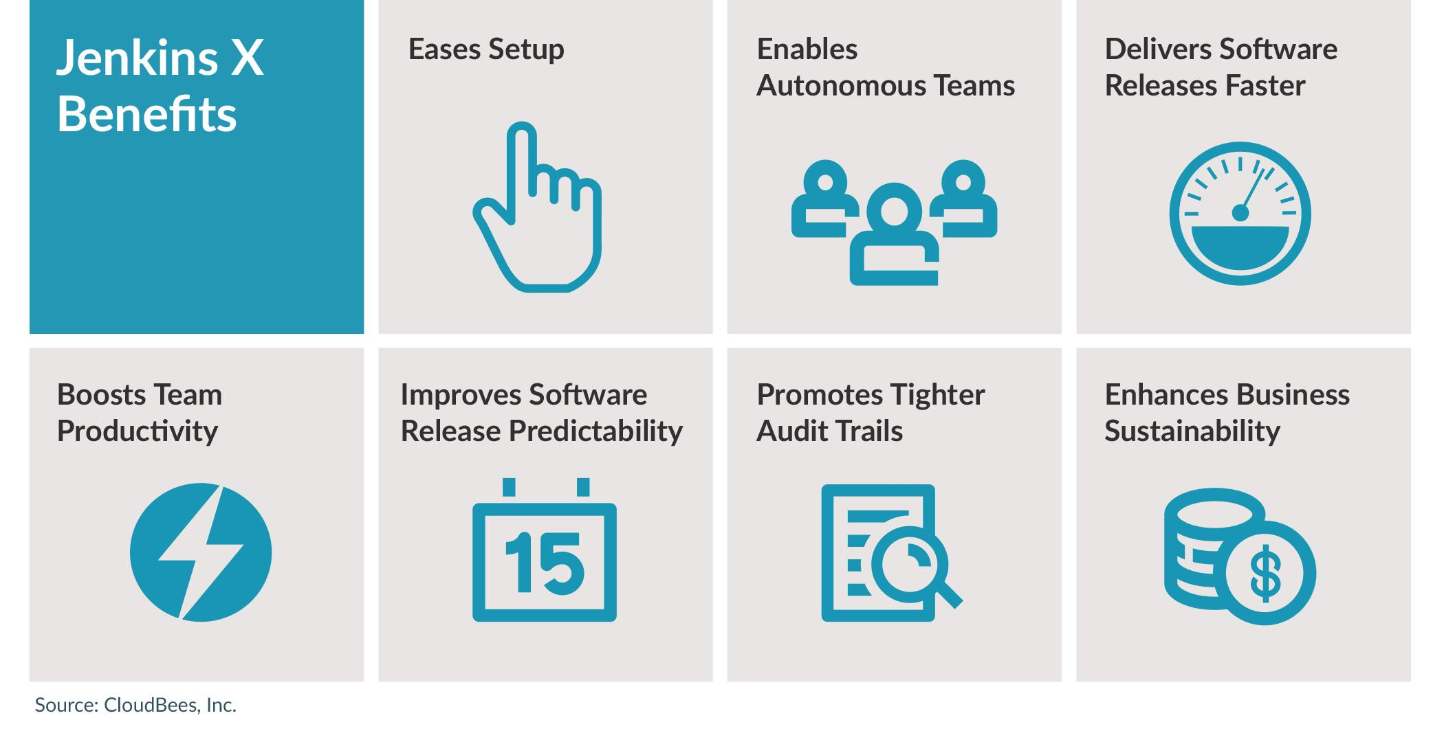
Jenkins X - Why You Should Care

Slide 7
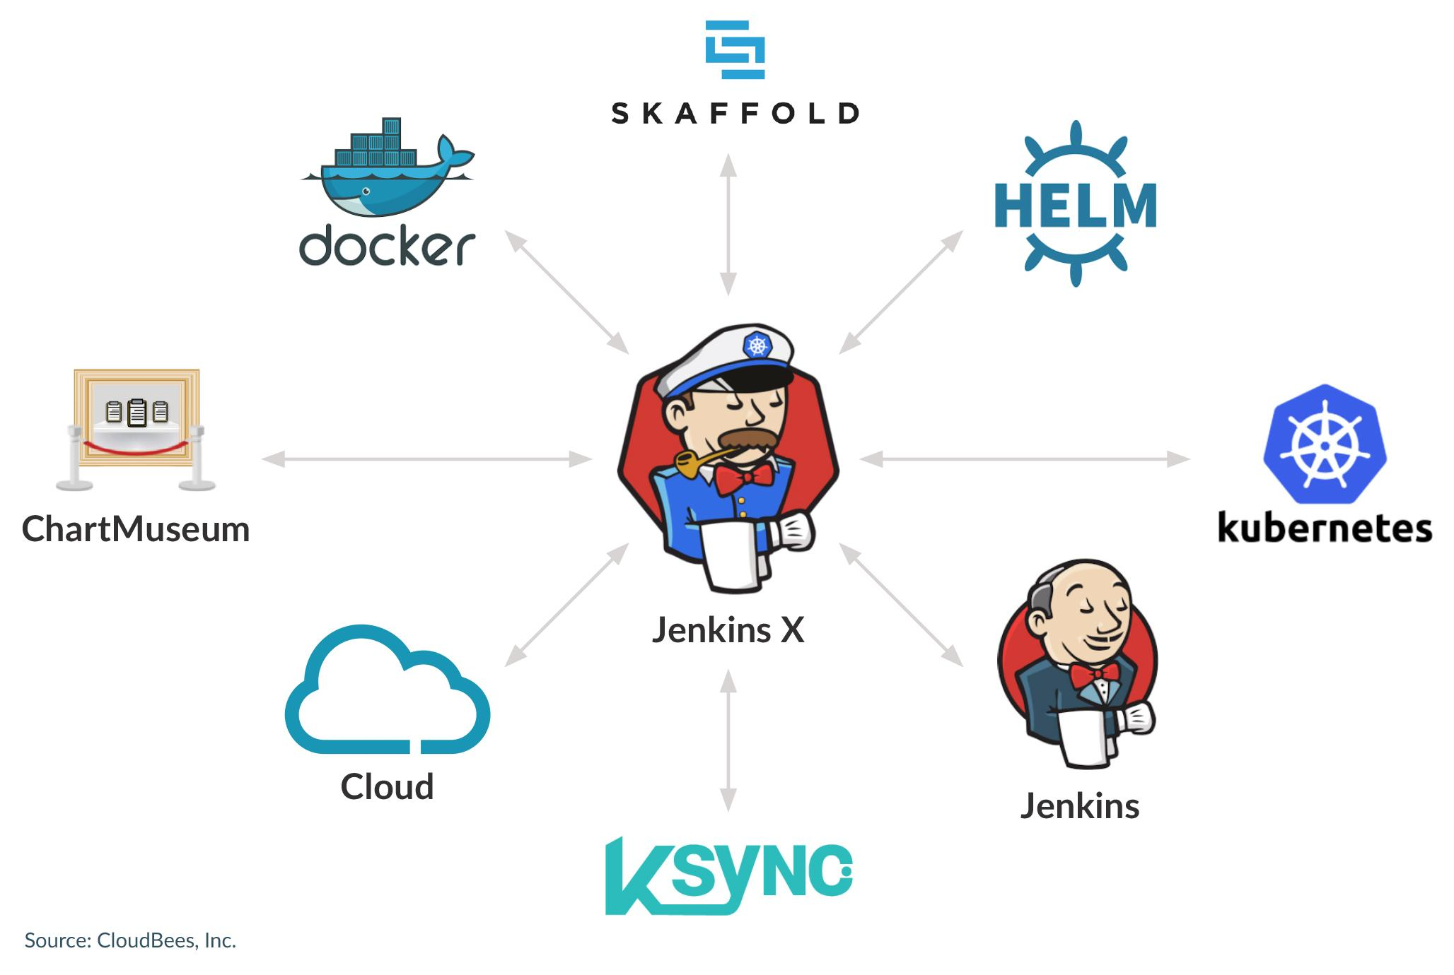
Eases Setup

Slide 8
Jenkins X - Why You Should Care

Slide 9
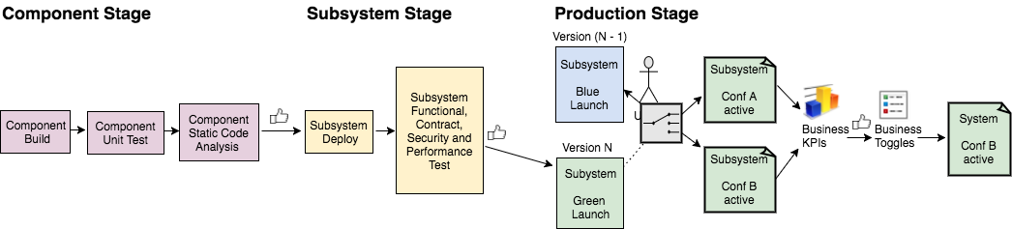
Enables Autonomous Teams
Time Personnel Tools

Slide 10
Jenkins X - Why You Should Care

Slide 11
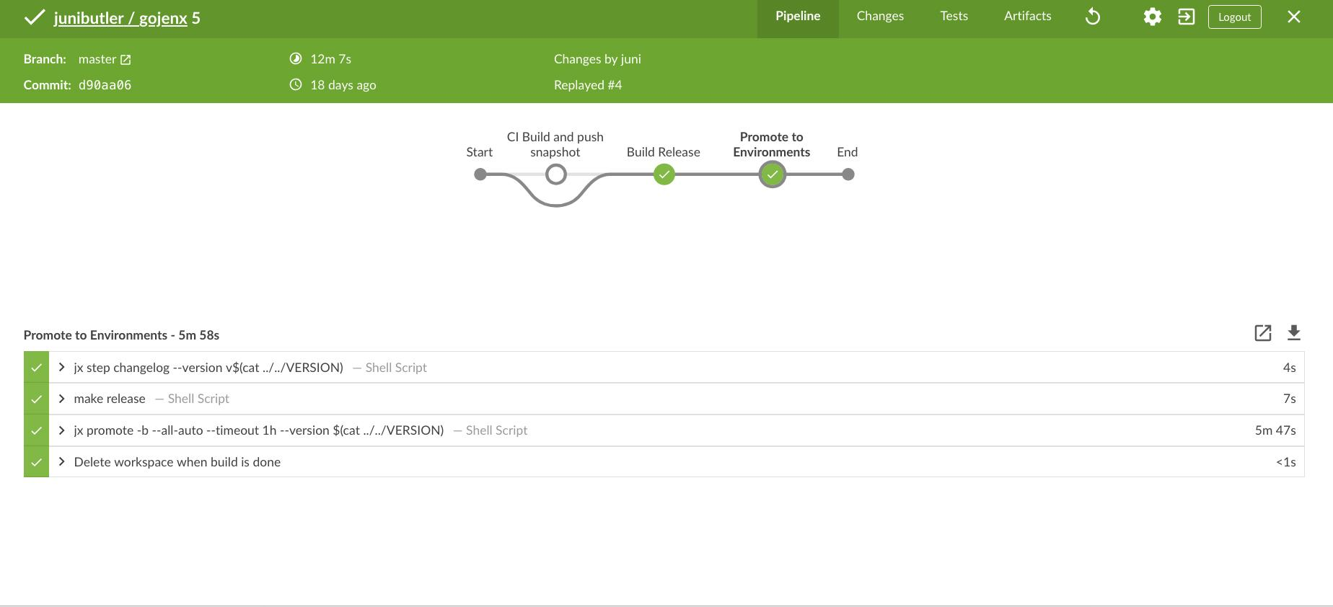
Delivers Software Releases Faster

Slide 12
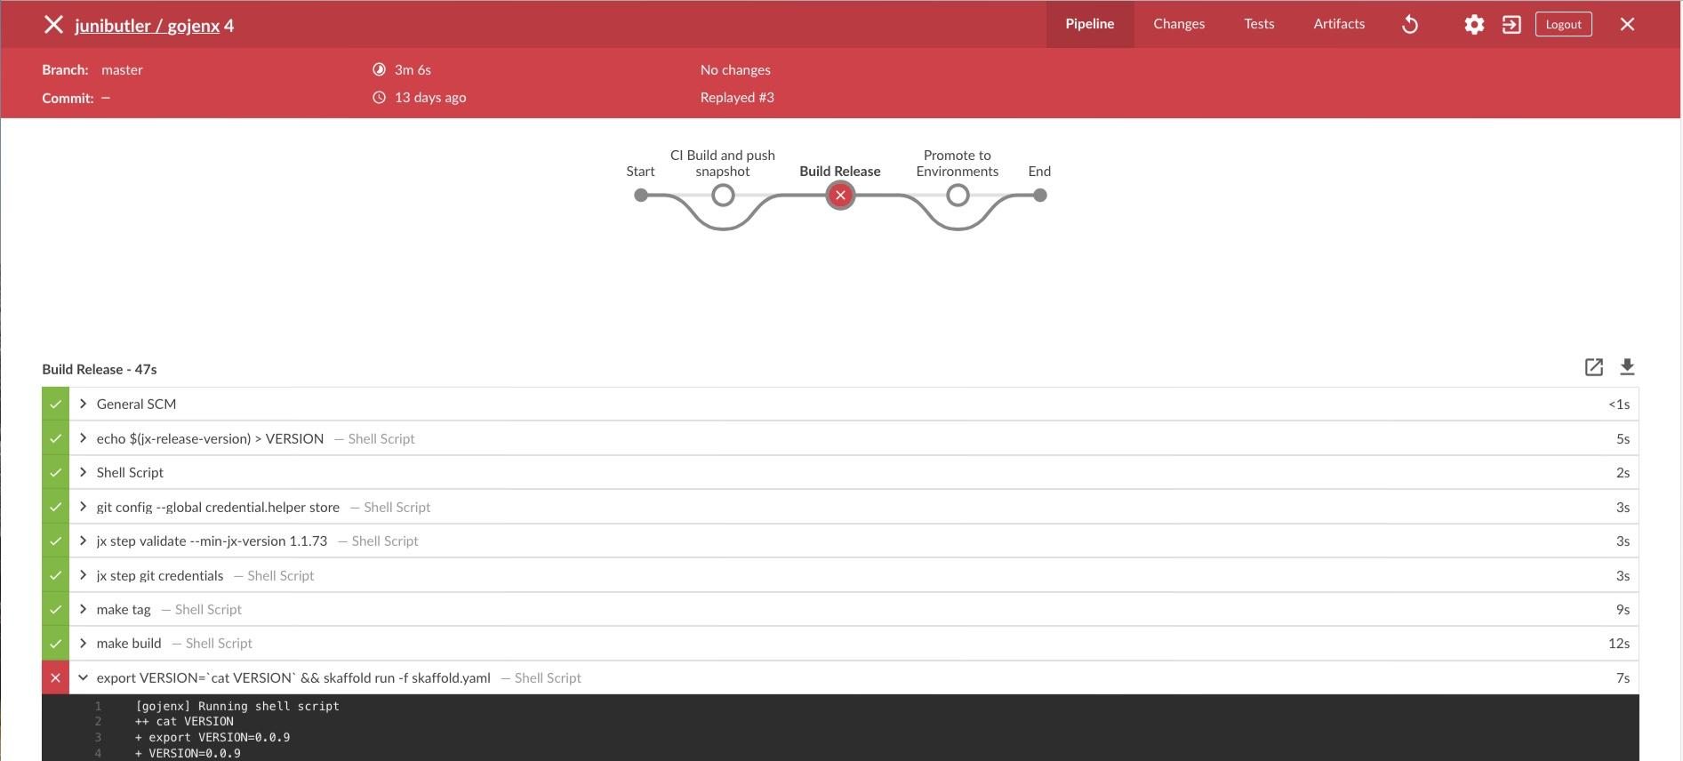
…But Safely.

Slide 13
Jenkins X - Why You Should Care

Slide 14
Boosts Team Productivity
Quickstarts
https://github.com/junibutler

Slide 15
Jenkins X - Why You Should Care

Slide 16
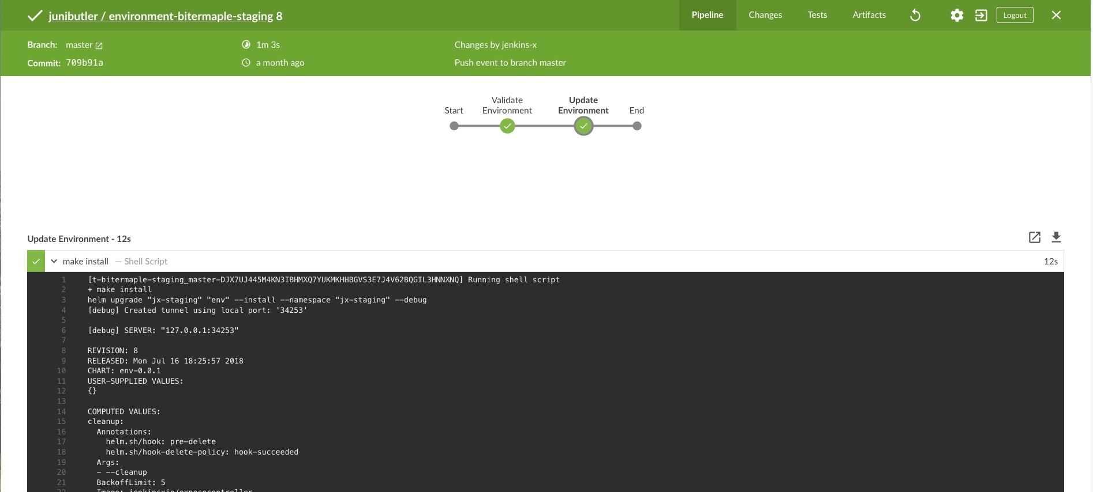
Improves Software Release Predictability

Slide 17
Jenkins X - Why You Should Care

Slide 18
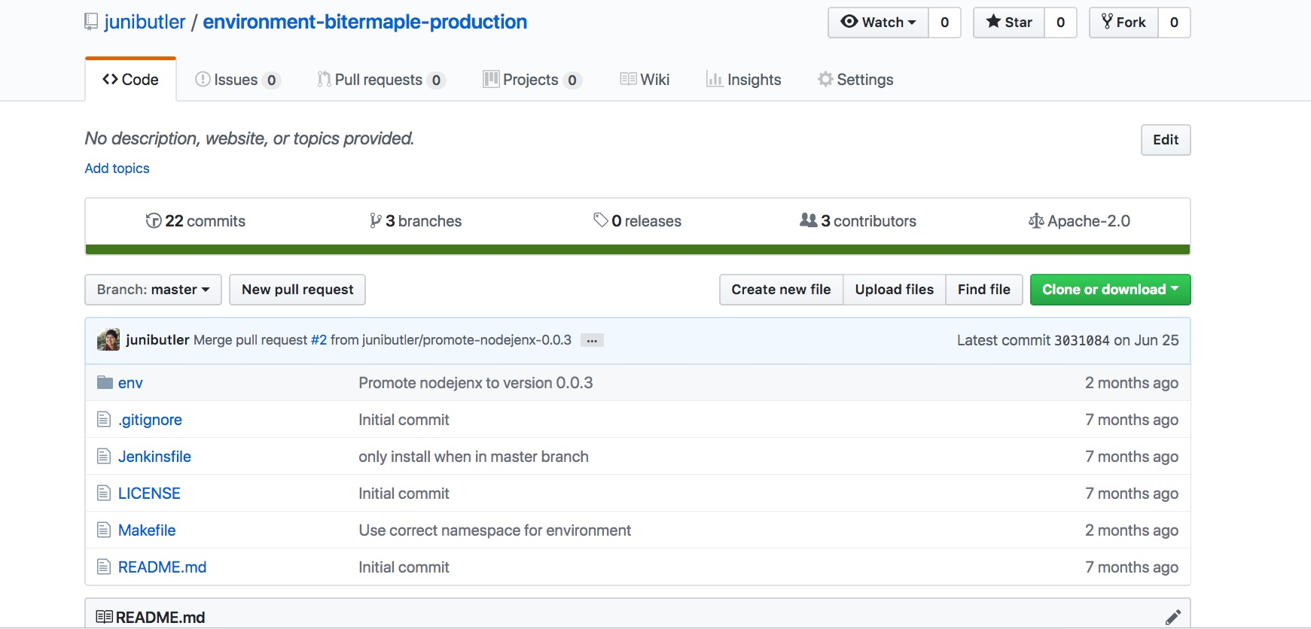
Promotes Tighter Audit Trails - GitOps!

Slide 19
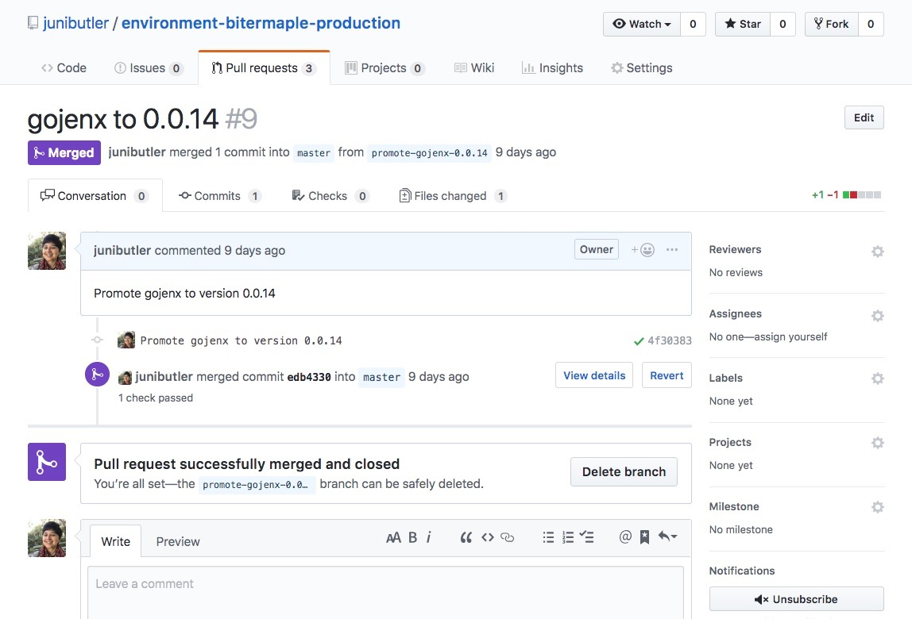
Promotes Tighter Audit Trails - GitOps!

Slide 20
Jenkins X - Why You Should Care

Slide 21

Enhances Business Sustainability
3P: Process-as-code + Pipeline-as-code + Productivity
3T: Traceability + Transparency + Trust
3C: Culture + Collaboration + Containers

Slide 22

Follow @cloudbees | Visit cloudbees.com

Slide 23
@CloudBees Resources
https://pages.cloudbees.com/AllDayDevOpsResources
Ebook - Building Cloud Native Apps Painlessly
Webinar - Easy CI/CD with Kubernetes
Webinar - Automated Continuous Everything For Cloud Apps on K8s
Whitepaper

Slide 25

@JuniTweets @CloudBees
I Say No To Treating Continuous Everything As
A Side Project. Let’s Do It With Pride!

